Slide 1

Web/iOS Development
Shyne
2014.10.06

Slide 2

Introduction
Class logistics
  Two 90 min sessions + one 15 min break
  Lectures + projects

Slide 3
This week
Business entity, project and technology
Within a technology company: roles and responsibilities
Software development life cycle
Software architecture overview
Software applications and tools

Slide 4
Today
Career advice
  Knowing yourself
  Startups or no startups
Within a technology company: roles and responsibilities
  Manager, product manager, project manager and engineer
Software develop life cycle – part I
  Day 1 at Alpha Camp - let’s build something!
  Autolist

Slide 5
[Career Advice]

Slide 6
Things I wish someone had told me when I graduated

Slide 7
Knowing yourself
Personality test
  http://en.wikipedia.org/wiki/Myers-Briggs_Type_Indicator
Career path
  Software engineer vs. lead engineer (R&D track vs. management track)
  Engineering vs. project manager
  Start your own business
Salaries are important. Having great potential is even more important
Pick a job that
  Looks good on your resume
  You can learn something from
  You don’t hate

Slide 8
Startups or no startups
Should I join a startup company?
Stable vs. flexible
Breadth vs. depth
  Jack of all trades or a specialist
Pursuing stability or following your dreams
Will I be rich if I join a startup company?
  Facts and numbers

Slide 9
Within a technology company
Roles and responsibilities

Slide 10
Roles and responsibilities
Officers
  CEO, COO, CTO/CIO, CMO/CSO, CFO
VPs
  VP of engineering, VP of sales, VP of HR
Directors and managers
As an engineer, you will work closely with
  Other engineers: PE / AE / FAE
  HR
  Project manager / product manager
  QA/SCM (software configuration management)
  System Admin

Slide 11
Roles in a startup company
Visionary / architect
  Idea generation, shape features, repositioning, market fit, competitive landscape, research.
Lead developer
  AKA Hackers. A good place to have a pair of jelled programmers. Uses web framework, creates functionality; knows Python/Ruby, Javascript, AJAX, Flash(?), HTML, databases.
System admin
  Network, web server, NFS (for VCS / file sharing), caching, other infrastructure, data backup, backup hardware, performance tuning, scalability.

Slide 12
Startup roles and responsibilities
Tool smith
  Team is provided with: productive development environments (all users can say “apt-get install …“), frameworks, editors, interpreters, multiple browsers, GIMP/Photoshop, (D)VCS, wiki, maybe BTS, quick training/consulting on tools/environment, continuous integration.
Webmaster.
  SEO, analytics, domain registration, site hosting, Apache/lighttpd.
DBA.
  Helps developers plan schema, set up tables, design for scalability, tuning/optimizing.

Slide 13
Startup roles and responsibilities
UI graphic designer
  Color coordination, logos, icons, image libraries, etc.
UX engineers / designer
  Usability, accessibility, layout, look-n-feel.
Technical writer / content creator
  User-facing documentation, populate/organize wiki, design tutorial, usage studies.
Customer support
  Answers phones, forum voice, FAQs, knowledge base, help entries, problem solving.

Slide 14
Startup roles and responsibilities
QA / tester
  Bangs on site, tries devious things, automates stress.
Marketer
  Evangelism, blogging, advertising.
Manager
  Coordinates all team member activities.
Lawyer
  Business setup, guidance, law interpretation.
Chef
  Handles all other (random) tasks to keep team functioning.

Slide 15
Takeaway
Choose your job wisely
Understand company culture before you join
The courage to say no and quit
Establish your professional network – it’s all about tit for tat
Google is your new best friend - do not reinvent the wheel

Slide 16


Slide 17
[Software development life cycle I]

Slide 18
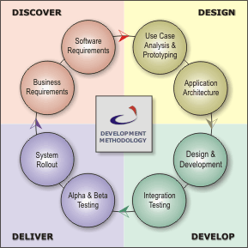
Overview
Describe a process for planning, creating, testing, and deploying an information system

Slide 19
Overview
http://www.youtube.com/watch?v=An7HC1LolDM&list=PLXjbhsOIwLP3J6bBfYyVcKglnIyJ3-xRX

Slide 20
Discover stage
Requirement analysis
Business requirement analysis
  Understand the business needs
  Translate the business needs into an objective, clear and specific language
  Determine the strategy to address the business needs
  Manage change of business needs
  Build solid relationships with all the parties
  The requirements should be documented, actionable, measurable, testable, traceable, related to identified business needs or opportunities, and defined to a level of detail sufficient for system design.

Slide 21
Discover stage
Requirement analysis
System requirement analysis
  Main idea -> convert business requirement analysis to a software requirement spec
http://www.cs.cornell.edu/courses/CS5150/2013fa/slides/D1-require-analysis.pdf

Slide 22
First day at work - Autolist
Let’s focus on the discover stage
Autolist – a market place for used cars
Executive summary
  General requirements
  Market research
  SWOT analysis
You are in charge of designing the software!!!

Slide 23
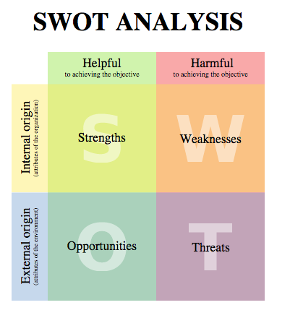
SWOT analysis
http://en.wikipedia.org/wiki/SWOT_analysis

Slide 24
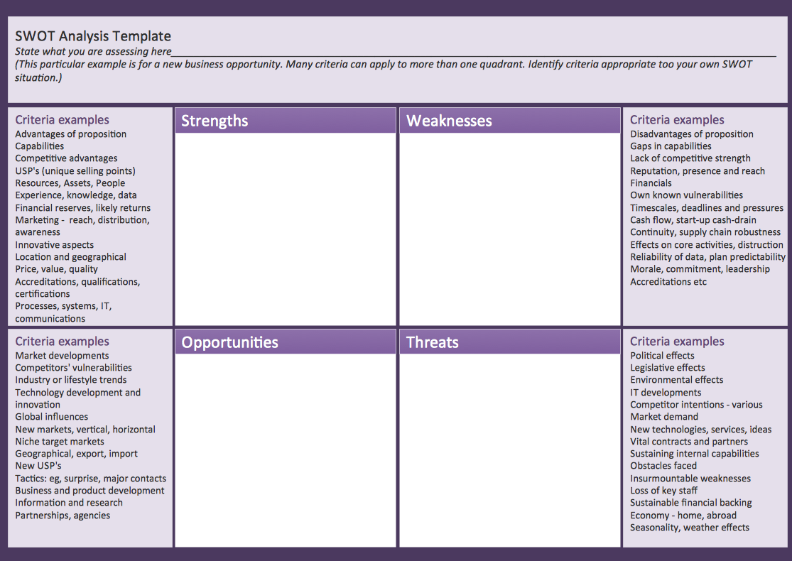
SWOT template for starting a new business

Slide 25
Homework
Get to know your classmates!
Try out http://o3o.cc/ninetest
Build your resume online – linkedin
Start a learning blog
Group discussion – Autolist
  Market research – knowing your competitors!!!
  Software requirement
  Feature list

Slide 26
~ END ~
http://www.alphacamp.tw

